Slide 1
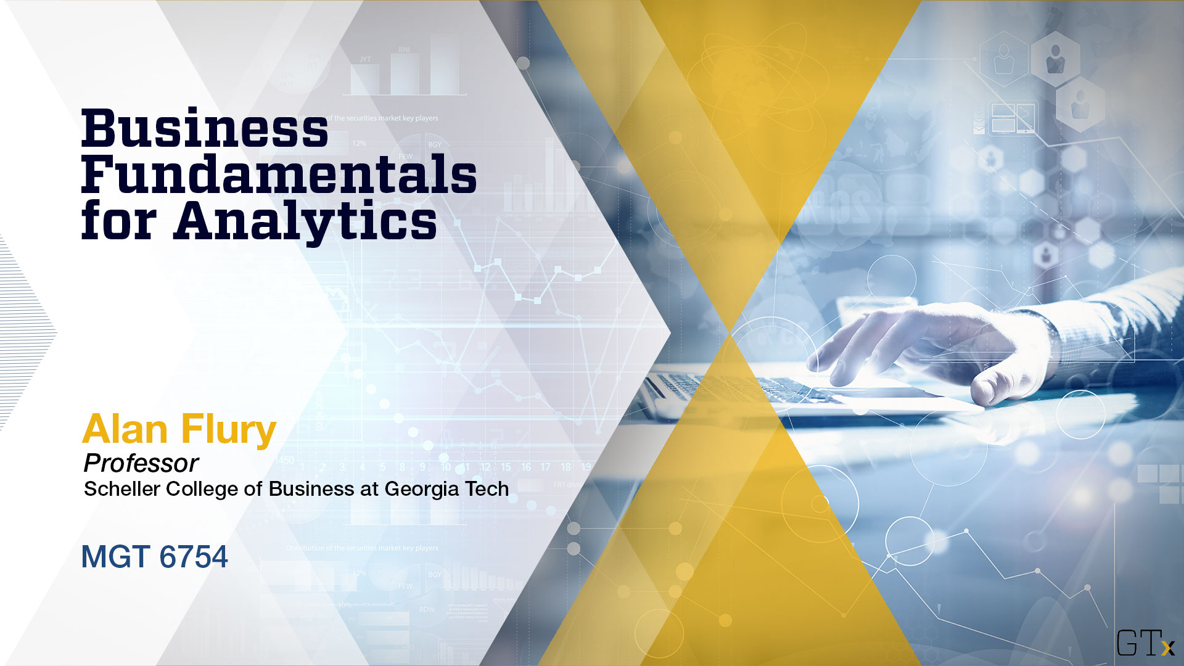
May 13 Videoconference
Alan Flury
Scheller College of Business

Slide 2
MGT8803 Business Fundamentals for Analytics Course Overview Objectives
To provide Data Analytics students with an accelerated introduction to basic business concepts and to enhance the analyst’s effectiveness in the business world.
Areas of Focus:
Accounting (Financial and Managerial)
Finance (Financial Analytical Techniques; Entrepreneurial Finance)
Business Strategy
Why Business Fundamentals?
Business Analytics and decision-making
Consider a waiver if you have an business UG degree, MBA, or a business minor (omsanalytics@gatech.edu)

Slide 3

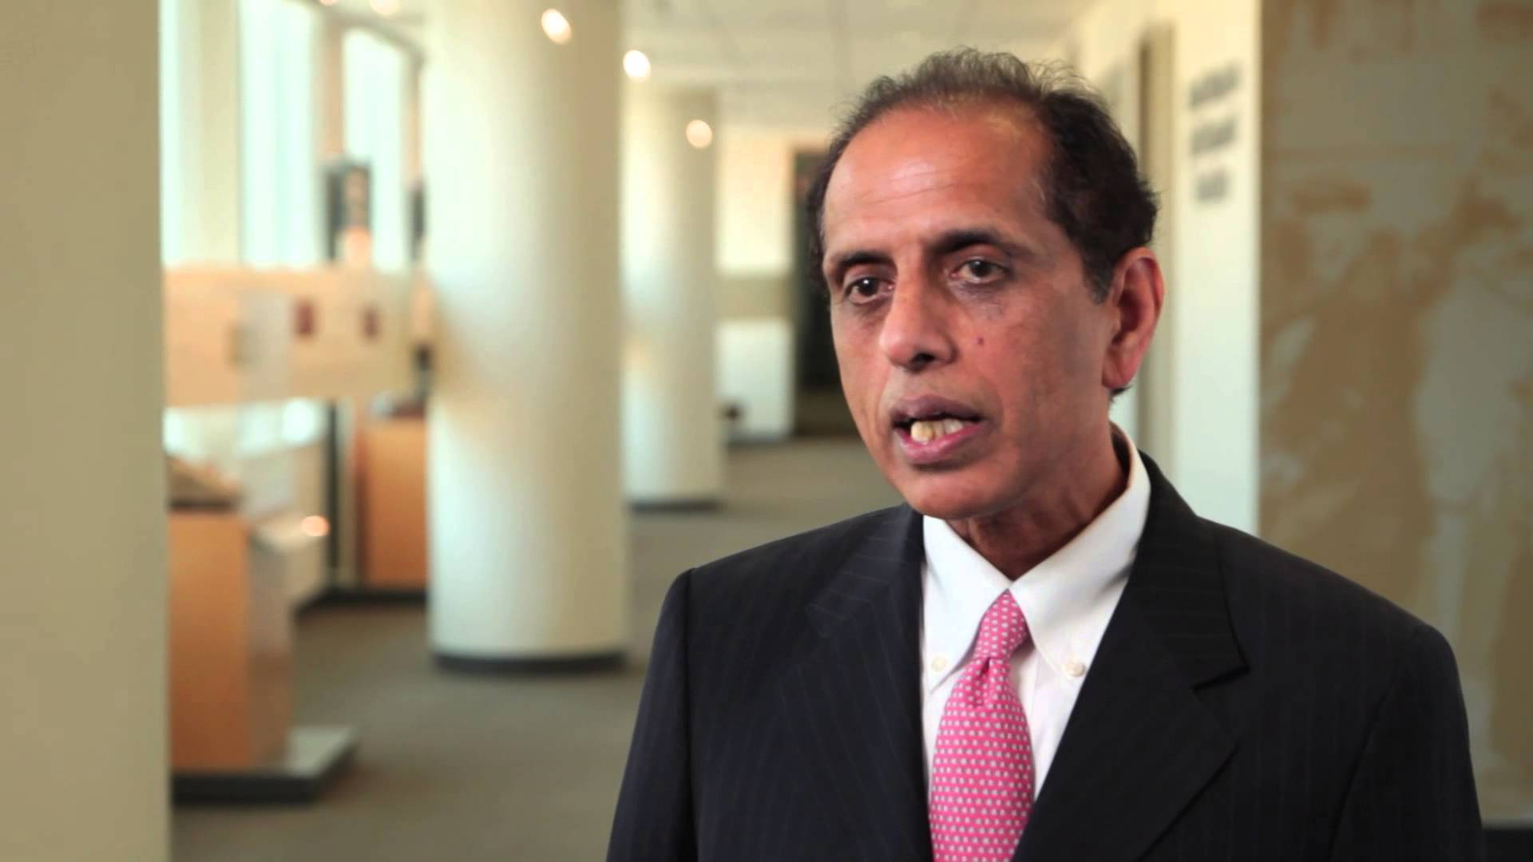
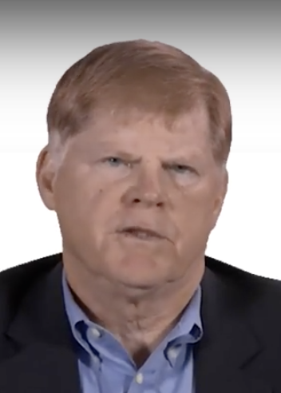
MGT8803 Business Fundamentals for Analytics Course Overview Topic Overviews
Financial Accounting
Managerial Accounting
Finance
Financial Analytical Techniques
Entrepreneurial Finance
Business Strategy and Innovation
Arnie Schneider
Narayanan Jayaraman
Alan Flury

Slide 4
MGT8803 Business Fundamentals for Analytics Course Overview Course TAs
Brett Tambling
Navya Pusapati
Raja Sarkar
Nathan Kurlansik
Cindy Orosz
Their job is to help the instructors monitor the forum and review the Procter Track recordings of flagged exams.

Slide 5
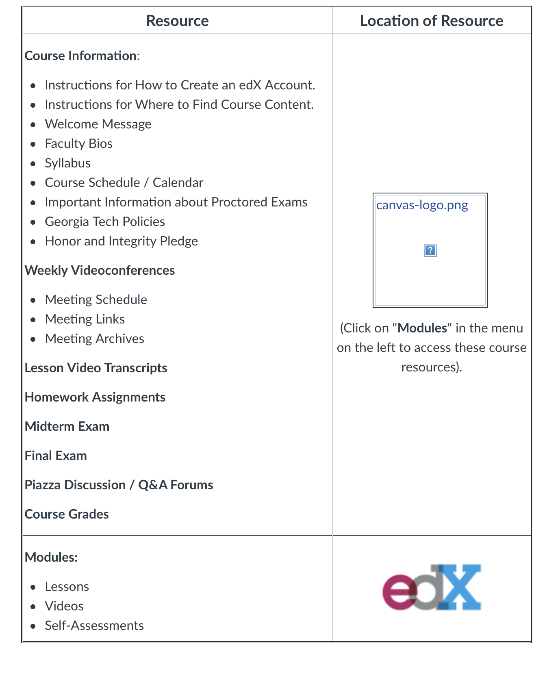

MGT8803 Business Fundamentals for Analytics Course Overview Educational Platforms
Canvas
edX
IMPORTANT: All Graded Work Is on CANVAS

Slide 6
MGT8803 Business Fundamentals for Analytics Course Overview Highlights
Course Packs
Strategy Module: eBook: Business Fundamentals for Analytics – Summer 2019 order: https://create.mheducation.com/shop/ (Links to an external site.)Links to an external site. ISBN 13: 9781307433623
All Other Modules: HBSP: Business Fundamentals for Analytics – Summer 2019. link: https://hbsp.harvard.edu/import/623583
Course packs are NOT required but recommended. Provide excellent source material for topics covered in video lessons.
.

Slide 7
MGT8803 Business Fundamentals for Analytics Course Overview Highlights
Grading
4 Homework Assignments – all count 5% of course grade
Mid-Term Exam – 40% of Course Grade
Final Exam – 40% of Course Grade
All homework and exam questions are either multiple choice, TF, or problems. No cases or essay questions.

Slide 8
MGT8803 Business Fundamentals for Analytics Course Overview Key Dates
Homework 1 Financial Accounting
Homework 2 Managerial Accounting
Homework 3 Financial Analytical Techniques
Mid-Term Exam
Homework 4 Entrepreneurial Finance
Final Exam
May 29
June 12
June 24
June 25 – June 30
July 10
July 26 – August 1
Exams are closed book, no formula or cheat sheets. Students will be allowed to use Excel and/or the calculator of their choice (all formulas must be cleared from memory before using on exam)
Homework assignments are open book and students are allowed to collaborate with each other. However the students ultimate work must be original and students are not allowed to discuss or post specific answers to the course forums. Student may ask instructors specific homework related questions in the forums but the post need to be marked as private.

Slide 9
MGT8803 Business Fundamentals for Analytics Course Overview Other
All weekly videoconference calls will be on Thursday evenings at 7 pm eastern daylight time except 2 calls as noted in the Meeting Schedule at the Canvas website. See Canvas for schedule and links.
Videoconference calls are an integral part of the course. If you cannot attend due to a schedule conflict, you should review the recording of the conference call after it’s is posted to the class website in Canvas. You will be tested on content discussed in the videocalls
Due to the potential volume of forum entries, forum posts that ask about topics or questions PREVIOUSLY answered in the videoconference calls will be referred back to the video call where the topic/question was addressed.
Any questions regarding the graded homework or exams posted to the forum need to be private.
You are not allowed to screen print or copy homework or exam questions or post homework or exam questions to any course related forum (includes slack)

Slide 10
MGT8803 Business Fundamentals for Analytics Course Overview Key Success Factors
Keep with the pace of the course. See schedule in Canvas. During each weekly video conference call the up coming week’s schedule will also be discussed.
Go through the lessons in order (as indicated in edX). Although not graded, complete the self assessments and try to work out any mistakes that you make. Prior to the exams also make sure that you complete all of the questions and problems in the sample exams.
Use the suggested readings to better understand the materials presented in the video lectures. Readings are listed in edX at the beginning of each module
Try to relate what you are learning in this course to your current job or to situations you encountered in previous work experiences
Monitor the forums and attend or view the recorded video conference calls. If you have a point of view regarding a forum entry please post it. To the extent you can, help out fellow students in the course.

Slide 11
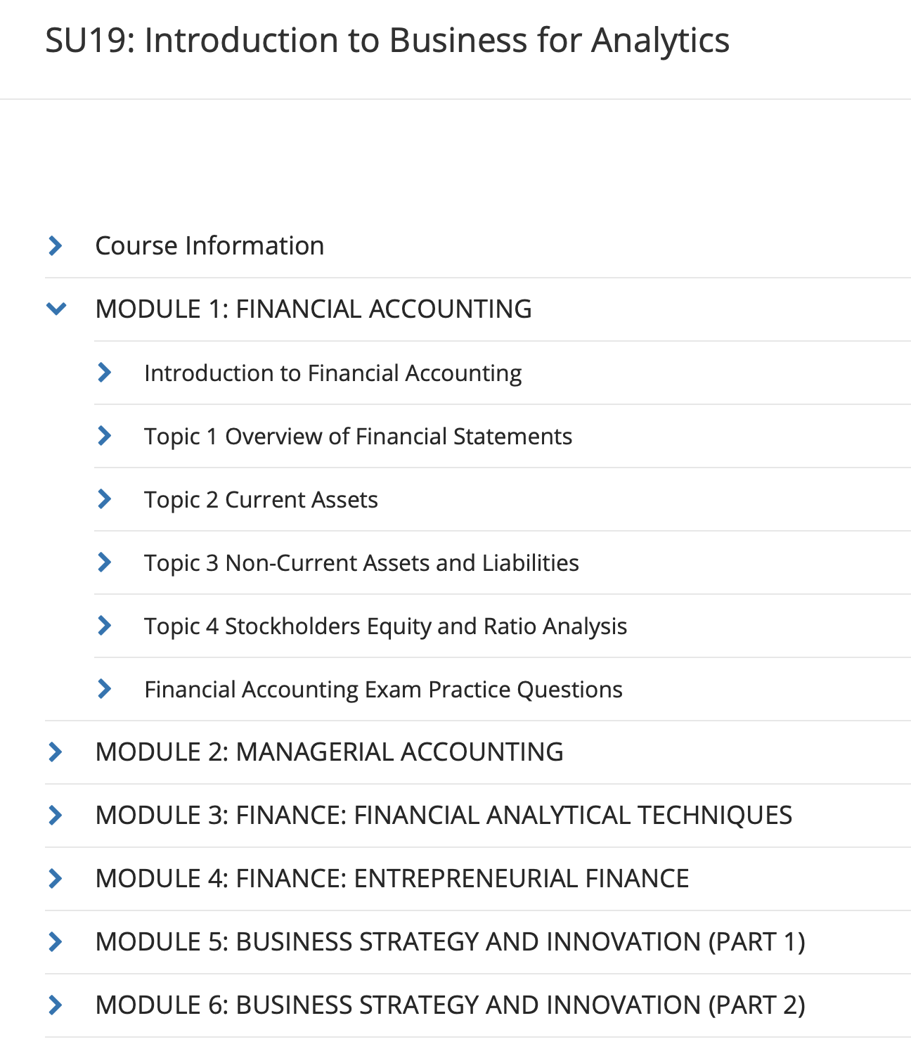
MGT8803 Business Fundamentals for Analytics Course Overview This Week
Be sure to complete the NCR Assignment before
the videoconference on May 16
Week 1 Focus
Week 2 Focus

